Slide 1
Cloud Data Encryption with BYOK and KYOK Jan 2019 IBM Confidential

Slide 2









Protect Data - Data-at-Rest Encryption
Key Management
Customers can encrypt their data stored in IBM Cloud and manage their own keys – across all supported data/storage services
Customer1
Objects
Data
BYOK
Objects
Key Protect
Data
Objectstore
Data Services (Cloudant, Cloud Databases)
Hyper Protect Crypto Services
VMs
VMWare
Hyper Protect Crypto Services
Block Storage (Volume)
Customer 2
Encryption needs are driven in the context of type of data customer uses
Data storage cut across – Block/Volume, Objects, and Databases/Data services
Key management, and especially customer managed keys/bring your own key

Slide 3
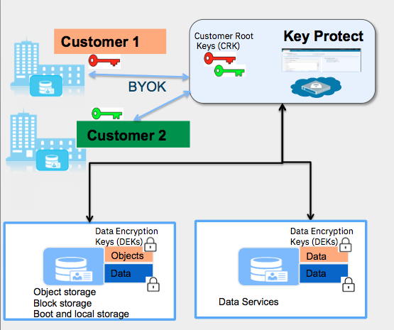
Storage and Data Services integrate with Key Protect to enable Data-at-rest encryption with BYOK
Customer Value: Customers want to achieve data security, by encrypting data at rest in IBM Cloud and manage their own keys – across all supported data/storage services
Approach: Delivering on this customer value requires
Key Protect supporting key lifecycle management, with critical security protections and compliance
Storage and Data services in IBM Cloud to adopt Key Protect consistently enabling BYOK
Available Capabilities in Key Protect
Customer Keys protected by HSM
Support encryption of application secrets with keys protected in HSM
Private Endpoints
Secure root key Import via Transport Keys
Key Deletion
Key Rotation
Fine grained Access Control for users, services, and applications
Audit logging of Key usage
© 2018 IBM Corporation
* Available in us-south region; with other regions to follow

Slide 4


Encryption Keys Used for Integration – E.g., with Cloud Object Storage
CRK (Customer Root Key): Either generated by the customer and imported (BYOK) or generated by Key Protect. CRKs are always encrypted when stored outside of HSM. It is not in clear text outside the HSM. All crypto operations involving this customer key happens within the HSM boundary
DEK (Data Encryption Key): used by data/storage services to encrypt customer data. This is always stored in encrypted form - encrypted with CRK.
Through envelope encryption, services request Key Protect to wrap or unwrap their DEKs with the CRK
Services can safely store wrapped DEKs along with their encrypted data and destroy the original unwrapped DEK
All crypto operations performed within HSM
KeyProtect
Customer 1
Customer Root Keys (CRK)
BYOK
1
Customer 2
3
Dec 2017
Data Encryption Keys (DEKs)
2
Objects
Objects
Objectstore
Services must not store DEK
in non-volatile memory
© 2018 IBM Corporation
Notes:
Owned by IBM vs Customer

Slide 5
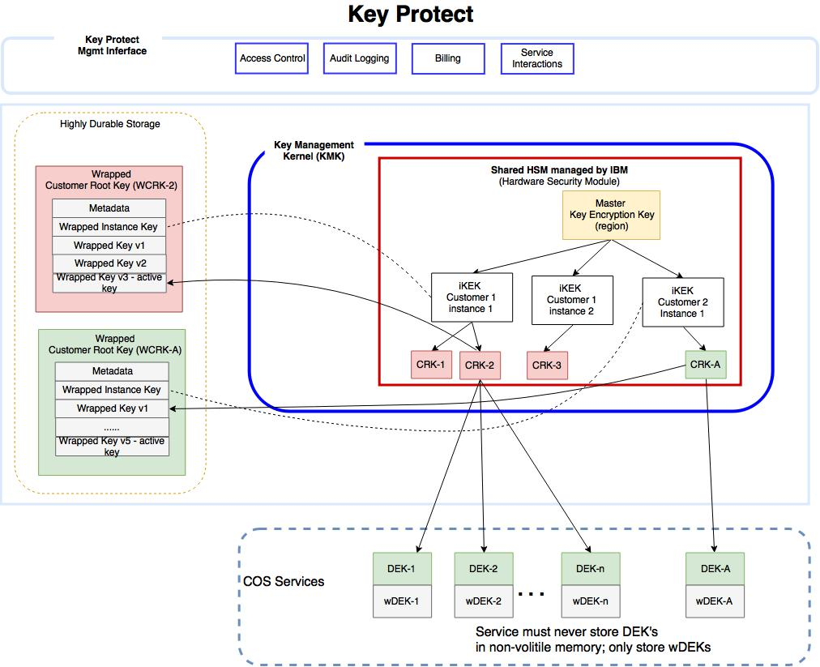
Key Protect Encryption Key Handling - Details
Customer 1
HSM (Hardware Security Module): FIPS-140-2 Level 2 certified cryptographic hardware that is shared in the public cloud. The master key never leaves the boundary of the HSM. All crypto operations such as creation, wrap, and unwrap are performed within the HSM.
KMK (Key Management Kernel): hardened trust boundary that interacts with the HSM.
Highly durable storage dedicated to Key Protect, that stores CRK metadata and encrypted CRK. The storage is encrypted at REST with additional application level encryption applied to metadata fields.
3
2
1
Customer 2

Slide 6
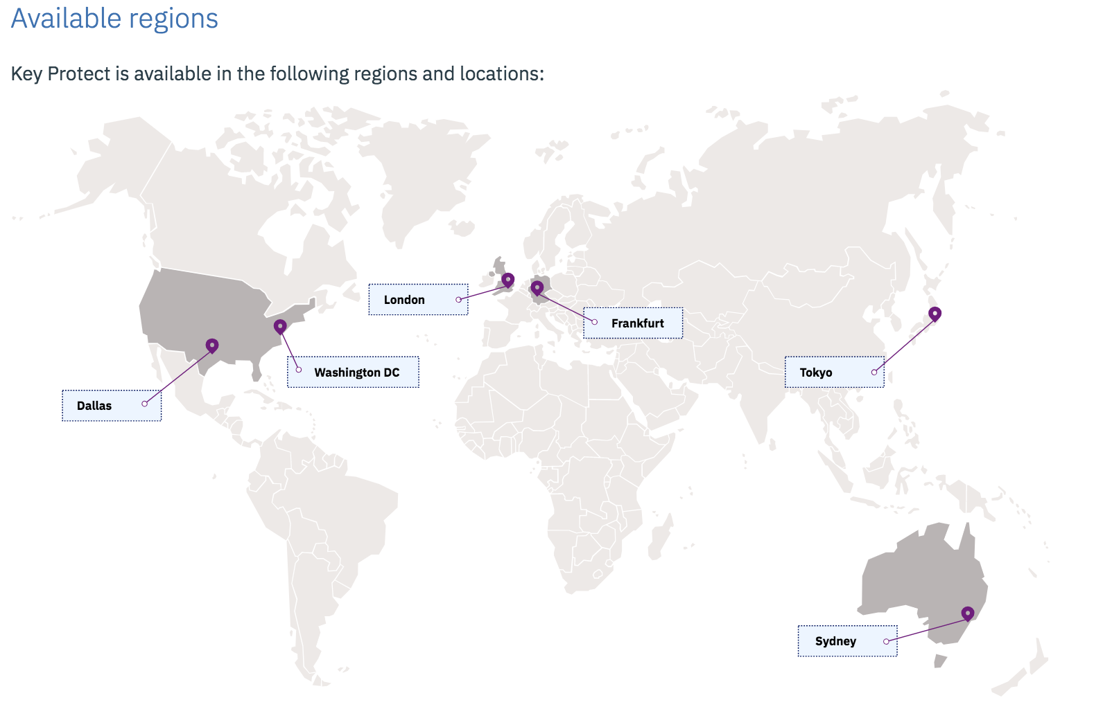
Key Protect – Geo availability, Compliance, and services integrated
Compliance
HIPAA ready | achieved
SOC2 Type I | achieved
SOC2 Type II | In progress
Service
Cloud Object Storage | Delivered
VSI Secure Boot & Local Disk | Delivered
IBM Cloud Databases Postgres, Redis, Elastic, Etcd | Delivered
IBM Cloud Databases MongoDB, RabbitMQ | Delivered
VPC Block Storage | 2Q 2019
VMWare | Delivered
DB2 | 2Q 2019
© 2019 IBM Corporation

Slide 7
Encrypting Data at Rest with increasing customer control
Bring Your Own Key (BYOK)
Keep Your Own Key (KYOK)
Customer brings their keys to the Cloud and manages them
Customer keeps their keys protected by the HSMs they control and manage
IBM responsibility
1
Key Management Service with IBM managed HSMs
Key Management Service with Customer managed HSM – Cloud HSM
2
Customer responsibility
On Premises
Key Management Service with Customer managed HSM -On Premise HSMs
3
Customer1
Customer 2

Slide 8





Encrypting Data at Rest with increasing customer control
Bring Your Own Key (BYOK)
Keep Your Own Key (KYOK)
Public – Key Management Key Protect
Multi-tenant key management service
Dedicated – Key Management/HSM Hyper Protect Crypto Service
Dedicated key management & Cloud HSM
Private – Key Management/HSM
Key Protect on ICp
Private key management with on-prem HSMs
IBM responsibility
IBM Cloud (Public)
IBM Cloud (Public)
IBM Cloud (Public)
Cloud storage & data services
Key Protect
APIs
Cloud storage & data services*
Cloud storage & data services*
1
Key Protect
Key Protect
APIs
Key Protect
APIs
Hyper Protect Crypto
Customer responsibility
2
IBM Cloud Private
On Premises
3
Key Protect on ICP
On-prem HSM
Customer1
Customer 2

Slide 9
IBM Cloud admins do not ever have access to customer keys
Key Lifecycle Management and support for Keep Your Own Key (KYOK) for cloud data encryption, with keys protected by customer controlled, dedicated cloud HSMs
Integrates using Key Protect APIs to secure IBM Cloud data and storage services
Provides industry's first and only FIPS 140-2 Level 4 certified HSMs in the public cloud market today
First cloud provider to provide dedicated (cloud) CLI for HSM Key Ceremony, supporting multiple personnel with crypto key responsibilities
Supports industry standards – PKCS #11
IBM Hyper Protect Crypto Services
Dedicated key management and cloud HSM service
Keep your own keys for cloud data encryption in a dedicated cloud HSM
Customer Benefits:
Full control of the entire key hierarchy including the HSM Master Key
Industry-leading security for Cloud data and digital assets
Reduced data compromise risk due to in-built protection against privileged access threats
Regulatory compliance through data encryption and controls on privileged access
BYOK: Bring Your Own Key
KYOK: Keep Your Own Key
HSM: Hardware Security Module
PKCS: Public Key Cryptography Standards
Built On
LinuxONE secure enclaves
Notes:
IBM Cloud Hyper Protect Crypto Services is a key management and cloud HSM service backed by IBM Z technology.
FIPS 140-2 Level 4 Certification:
The Federal Information Processing Standard (FIPS) Publication 140-2, is a US government computer security standard used to approve cryptographic modules. Hyper Protect Crypto Services is the only HSM to be FIPS 140-2 Level 4 certified in the public cloud market today.
FIPS 140-2 defines four levels of security.
Level 1: Security Level 1 provides the lowest level of security. No specific physical security mechanisms are required in a Security Level 1 cryptographic module beyond the basic requirement for production-grade components.
Level 2: Security Level 2 improves upon the physical security mechanisms of a Level 1 cryptographic module by requiring features that show evidence of tampering, including tamper-evident coatings or seals that must be broken to attain physical access to the plaintext cryptographic keys and critical security parameters (CSPs) within the module, or pick-resistant locks on covers or doors to protect against unauthorized physical access.
Level 3: Physical security mechanisms required at Security Level 3 are intended to have a high probability of detecting and responding to attempts at physical access, use or modification of the cryptographic module. The physical security mechanisms may include the use of strong enclosures and tamper-detection/response circuitry that zeroes all plaintext CSPs when the removable covers/doors of the cryptographic module are opened.
Level 4: Security Level 4 provides the highest level of security. At this security level, the physical security mechanisms provide a complete envelope of protection around the cryptographic module with the intent of detecting and responding to all unauthorized attempts at physical access. Penetration of the cryptographic module enclosure from any direction has a very high probability of being detected, resulting in the immediate deletion of all plaintext CSPs
Key Ceremony:
The Root Key Ceremony is a standard industry procedure by which a unique pair of public and private root keys are generated and stored securely,
IBM is the first cloud provider to provide dedicated (cloud) CLI for HSM Key Ceremony, supporting distinct HSM management and key holder roles
For steps to get started see https://console.bluemix.net/docs/services/hs-crypto/initialize_hsm.html#initialize-hsm

Slide 10

Data at rest encryption - Keep Your Own Key (KYOK)
KYOK - Customers have more control and authority over their data with encryption keys that they can bring, control and manage
IBM Hyper Protect Crypto Services
Dedicated key management service
Enables data at rest encryption for cloud data and storage services
Provides Keep Your Own Key (KYOK) i.e. BYOK with keys protected by customer controlled, dedicated cloud HSMs
Integrates using Key Protect APIs
Industry’s highest level security with FIPS 140-2 Level 4 certification
Customer 1
Customer 2
IBM Cloud Key Protect
Multi-tenant key management service
Supports Bring Your Own Key (BYOK)
Keys protected by IBM controlled HSMs
Key Protect APIs
Key Protect
Hyper Protect Crypto Services
Hyper Protect Crypto Services
Notes:
IBM offers two options for Key Management:
IBM Key Protect is a multi-tenant service that uses IBM controlled HSMs to protect the encryption keys – customers can bring their own key (BYOK) or generate one
For customers that are looking for complete control over their keys and HSMs, IBM Hyper Protect Crypto Services provides a ‘Keep Your Own Key’ (KYOK) option which allows keys to be protected by dedicated cloud HSMs

Slide 11
Highest level of security for your data and keys
Dedicated HSM with Hyper Protect Crypto capabilities built on mainframe technology
Secure Enclaves | Key safety | Simplified Security
Platform-enforced confidentiality and security for the cloud Built-in tamper resistance and pervasive encryption data in use, in transit and at rest Locks out privileged users for protection against abusive use of system admin or root user credentials | Secure Key technology ensures customer keys are never in the clear On board HSM with tamper resistant cards providing FIPS 140-2 Level 4 security | Docker-base stack inherits security without any code changes Malware protection via whitelisted execution environment
Scalability: Scalable to +1300 security domains in a single system footprint

